Slide 1
Library Management System

Slide 2
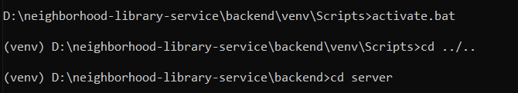
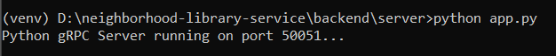
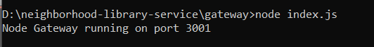
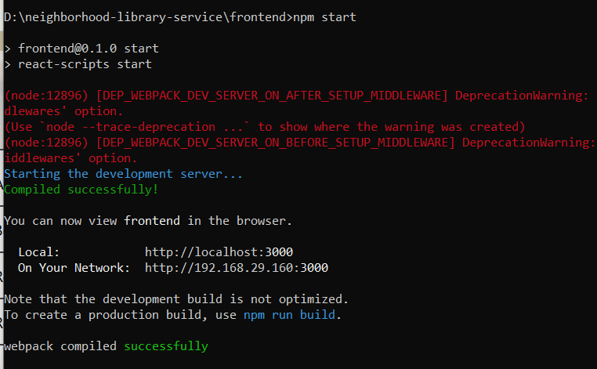
Environment Starting steps:
Backend process starting (gRPC server) :
Gateway process starting (Node Js)
Frontend process starting (React) :

Slide 3
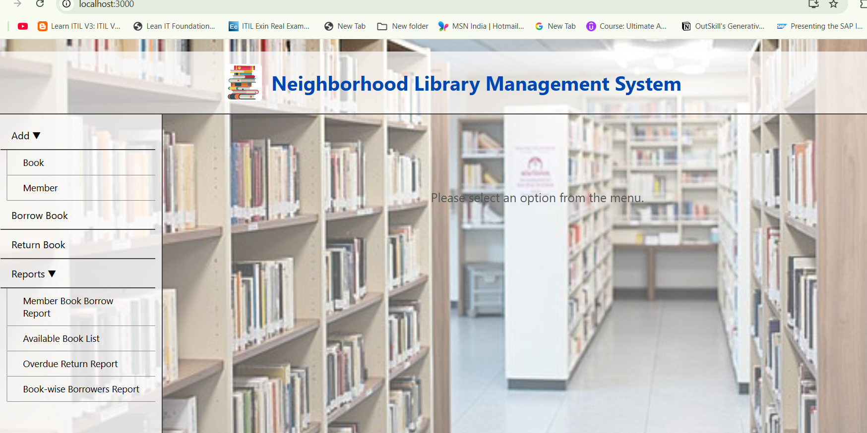
React App GUI (localhost:3000)

Slide 4
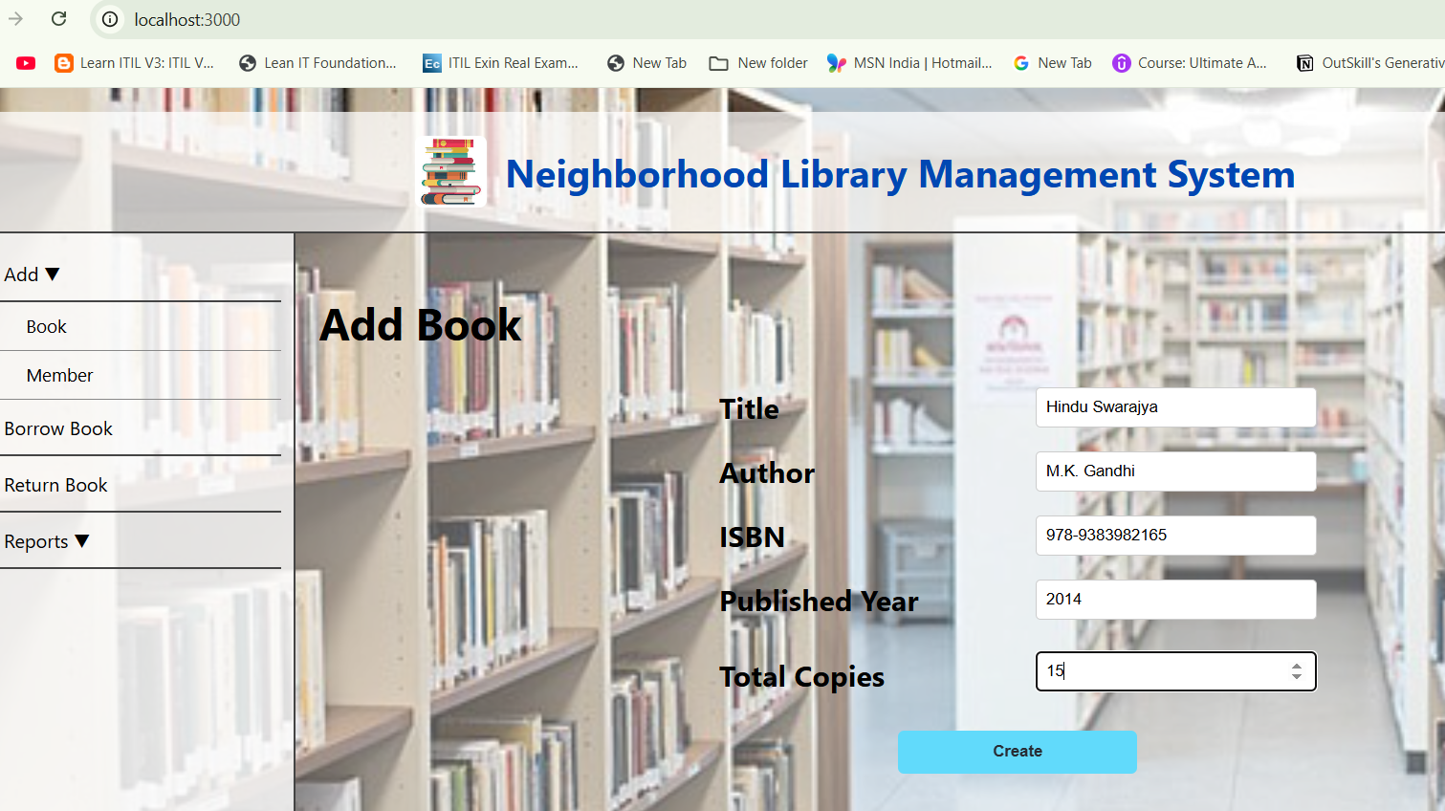
Scenario: Add Book Module that allows users to add new books to the inventory

Slide 5
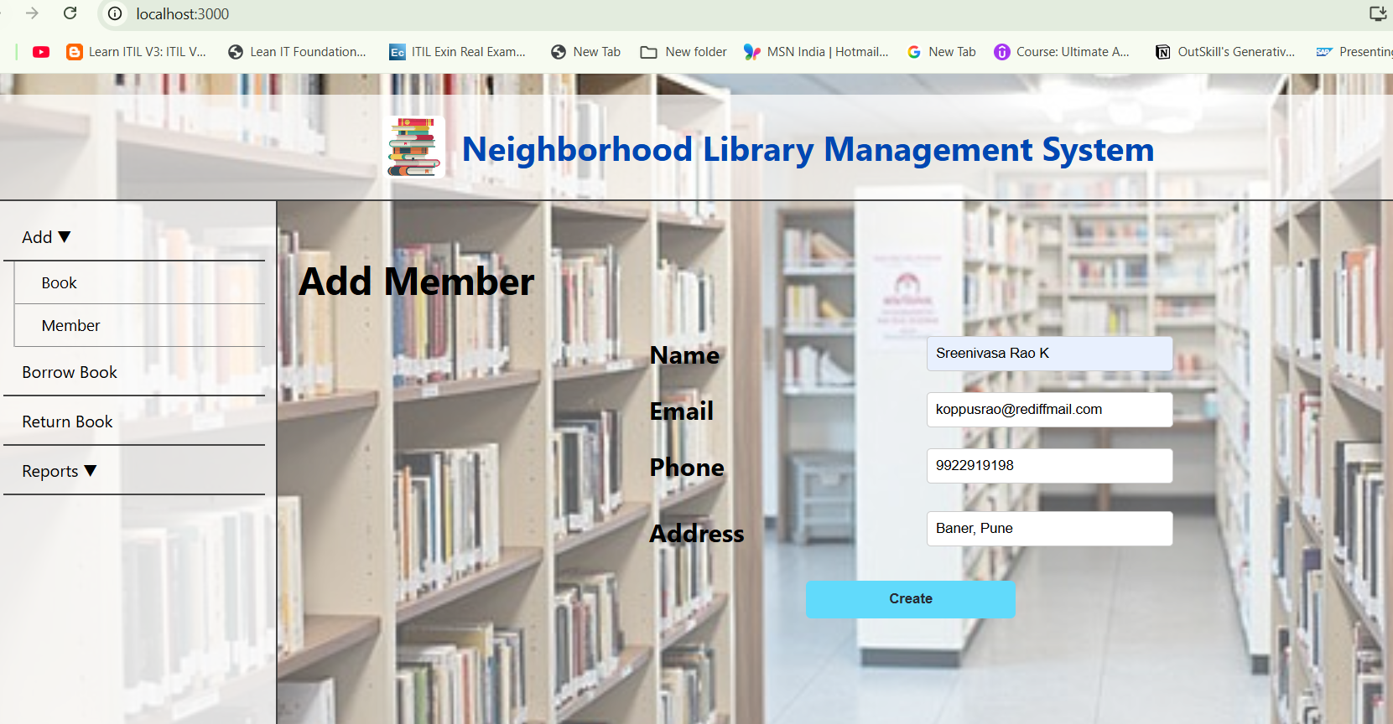
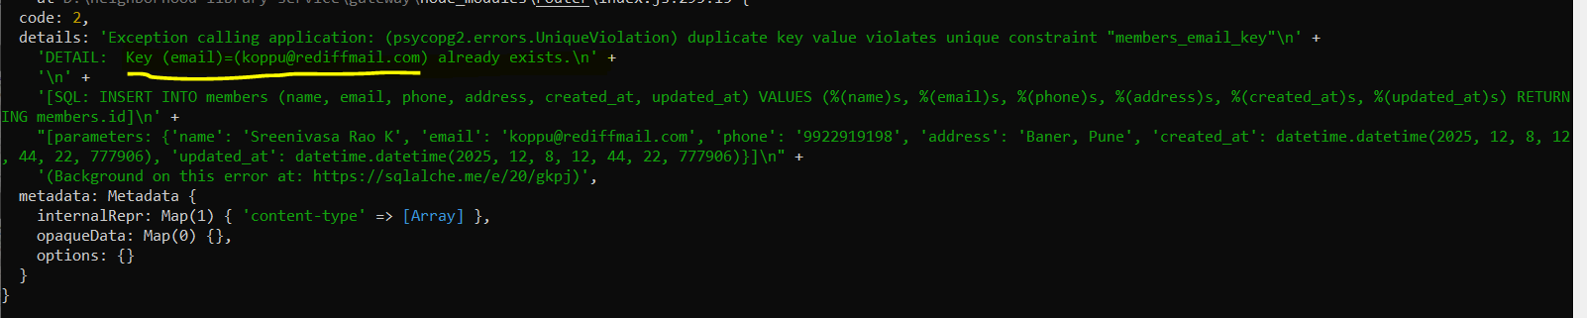
Scenario: Add Member Inventory screen for adding new members
Exception throwing if use existing mail id:

Slide 6
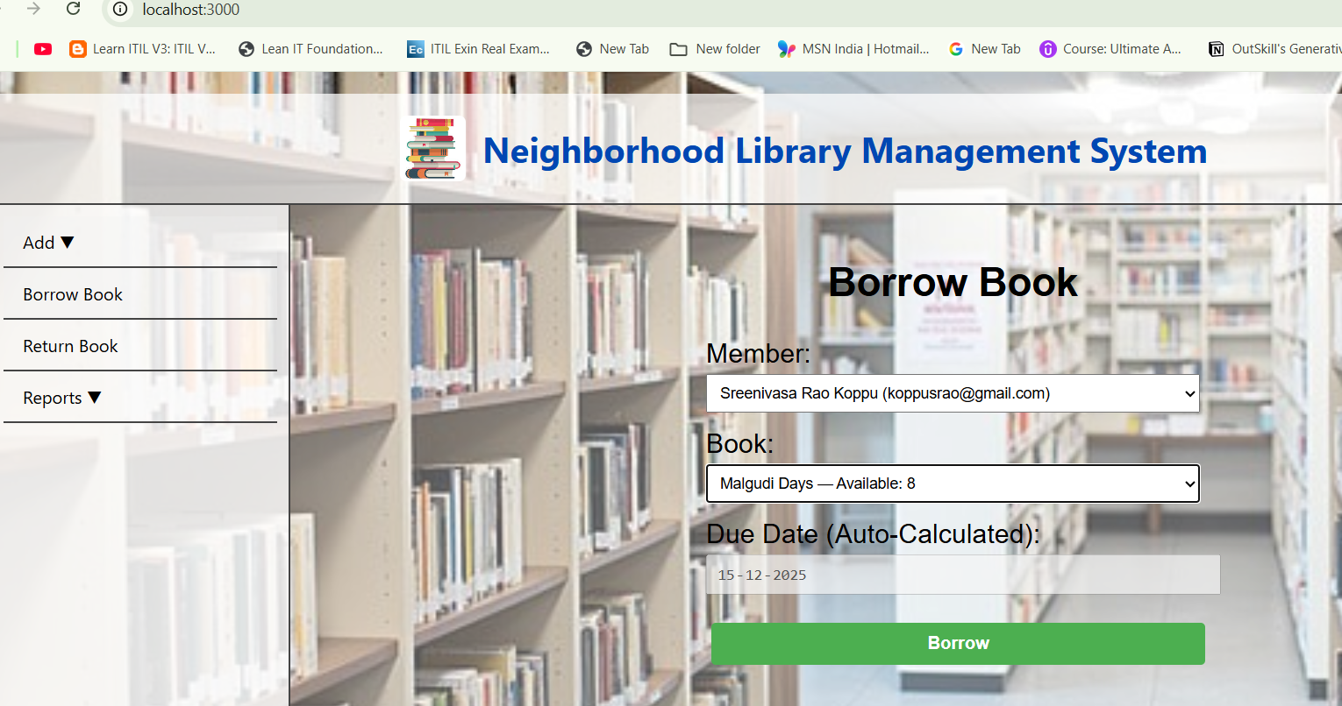
Scenario: Borrow Book “Screen used for borrowing books. When a book is issued, the system automatically updates the available quantity. The due date is auto-calculated as 7 days from the borrowing date.”

Slide 7
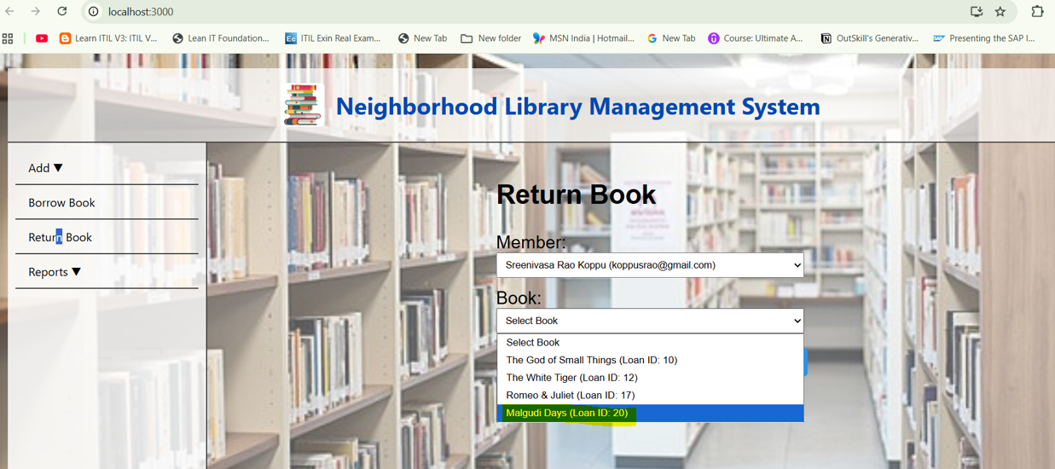
Scenario: Return Book Return screen for processing book returns. When a member returns a book, the available stock is automatically updated.

Slide 8
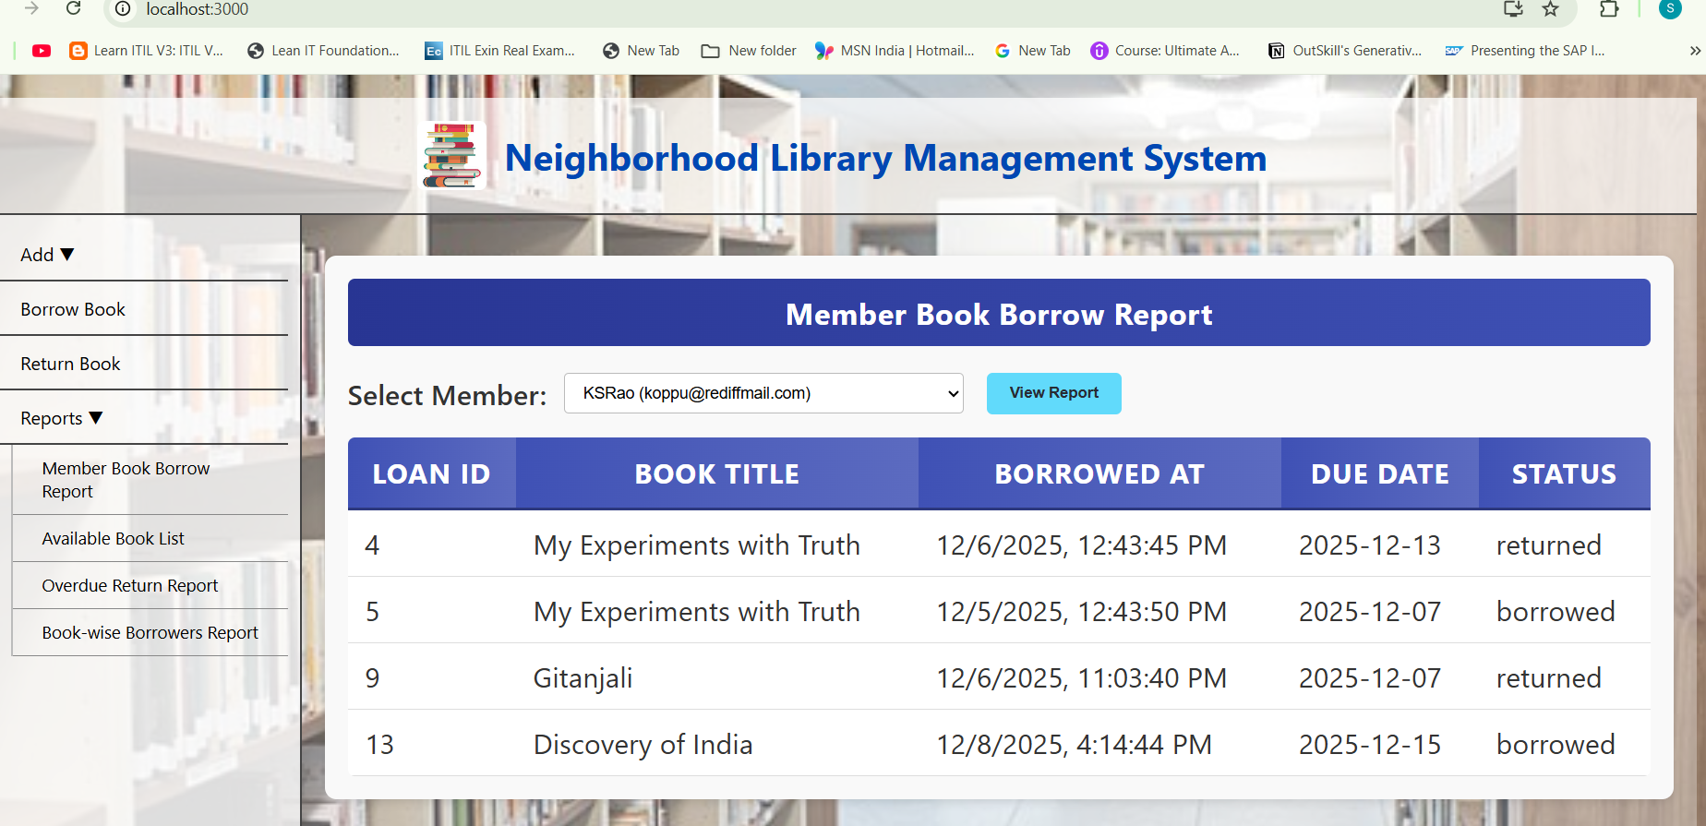
Scenario: Reports “Report screen for ‘Member – Book Borrow Report’. Generates a detailed report of books borrowed or returned based on the selected member.”

Slide 9
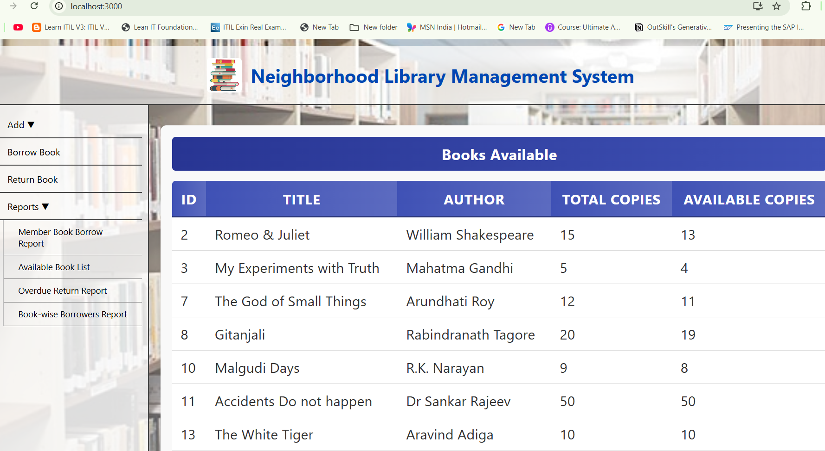
Scenario: Reports – Books Available Report screen that provides details of each book’s total copies and current available stock.

Slide 10
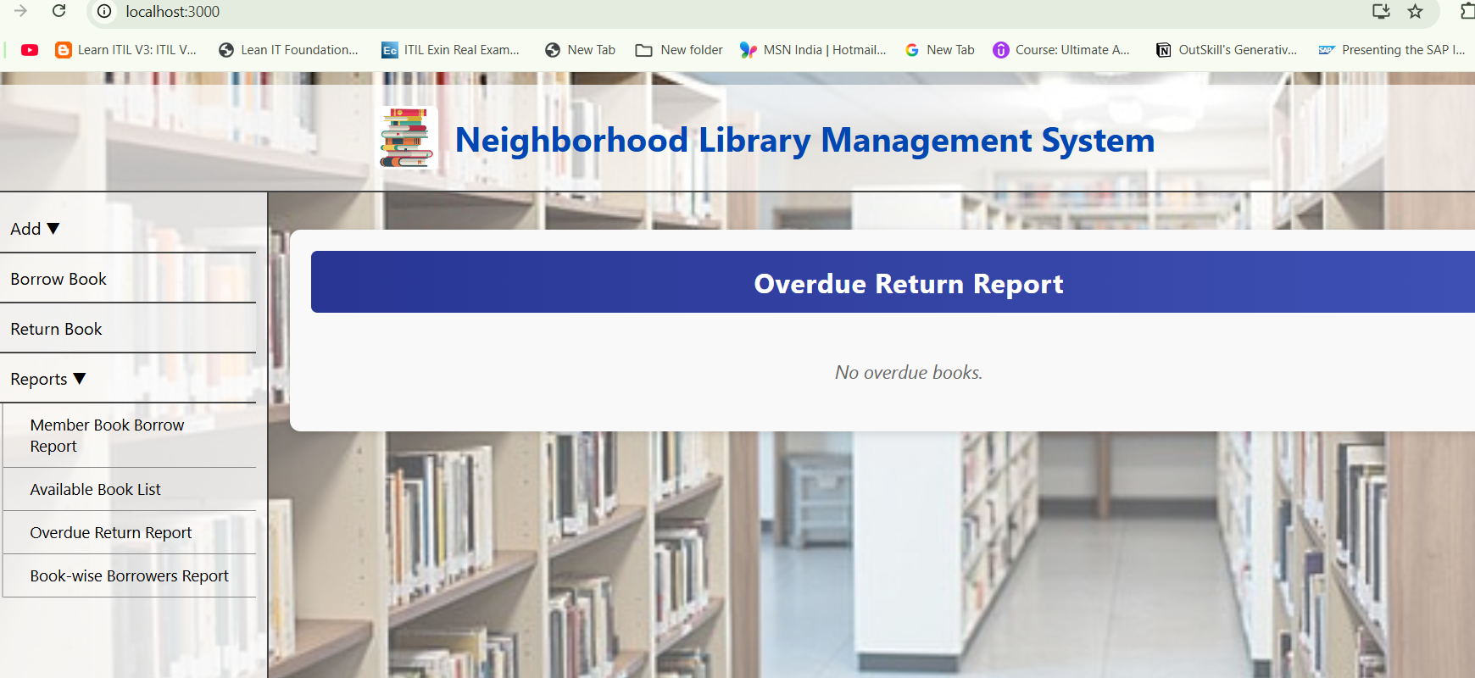
Scenario: Reports “Report screen for ‘Overdue Report’. Provides details of members who have not returned books past the due date.”

Slide 11
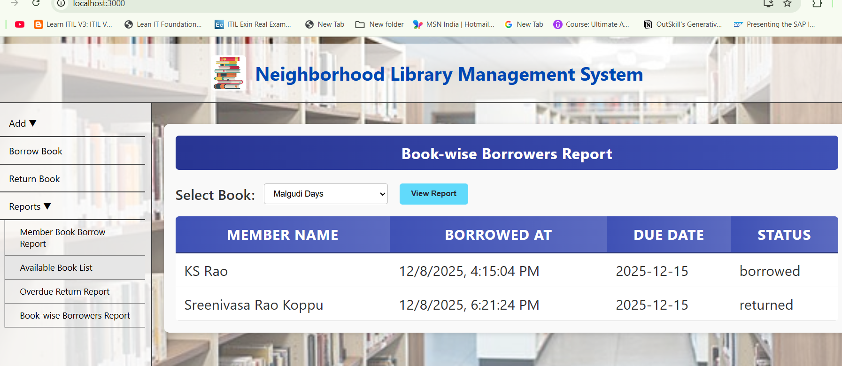
Scenario: Reports – Book-wise Borrowers: “Report screen for ‘Book-wise Borrowers Report’. Provides details of borrowers for each book.”

